Slide 1

Timetabling in Academic Institutions problem using genetic Algorithms
Florentin Niyongere

Slide 2
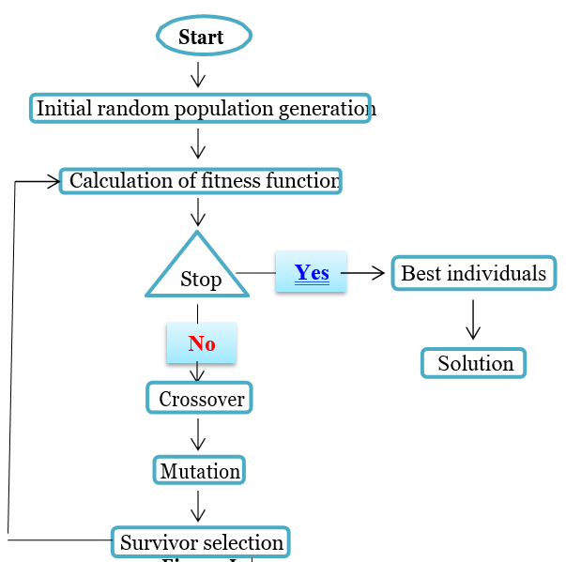
Description
An Algorithm that explains how Genetic Algorithm work to choose the best fit for chromosome and generate the best generation.

Slide 3

Applications
Course Scheduling
Exam Scheduling
Events scheduling
Transportation Planning
Healthcare Organisation
etc

Slide 4
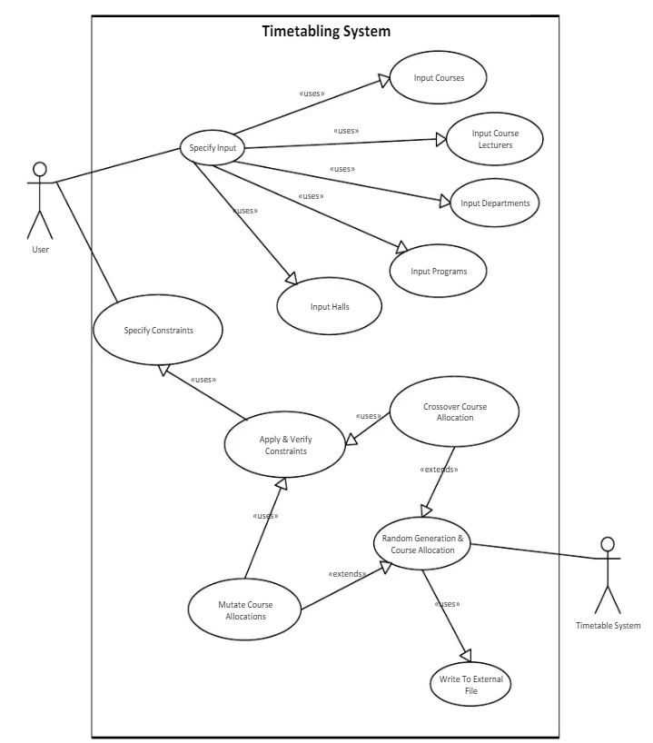
Experimentation and methods

Slide 5
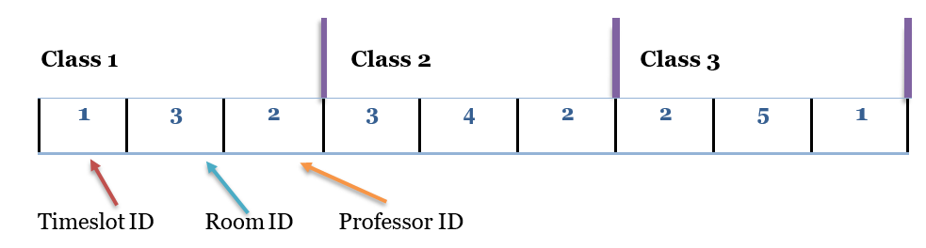
Chromosome Structure
Array of K integer
It is divided into three parts:
Timeslot ID
Room ID
Professor ID
Example of a chromosome:
Number of classes = 3
Number of parameters = 3

Slide 6
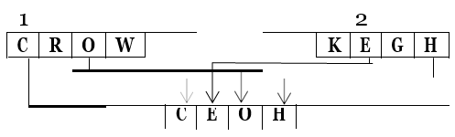
Crossover

Slide 7
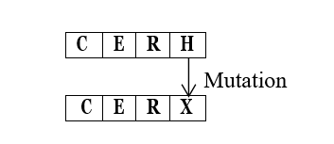
Mutation

Slide 8
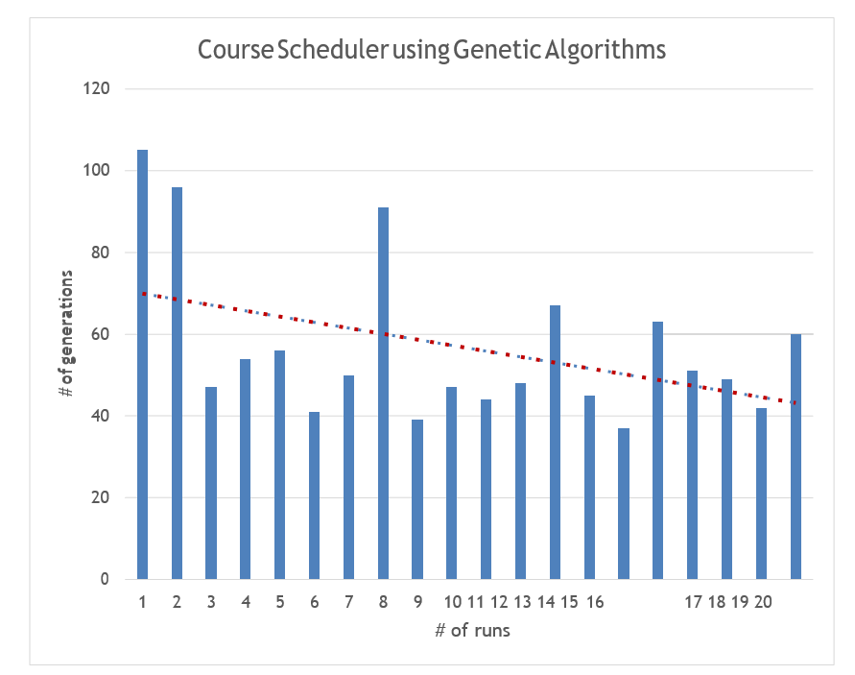
Results
The number of generation the course scheduler takes to find the optimal solution

Slide 9
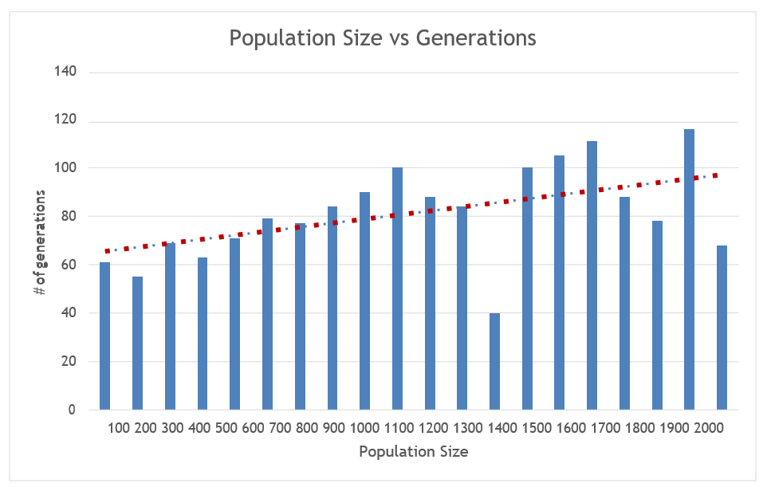
Result
The increase in population size shows a steady increase in the number of generations that takes to reach a valid solution.

Slide 10
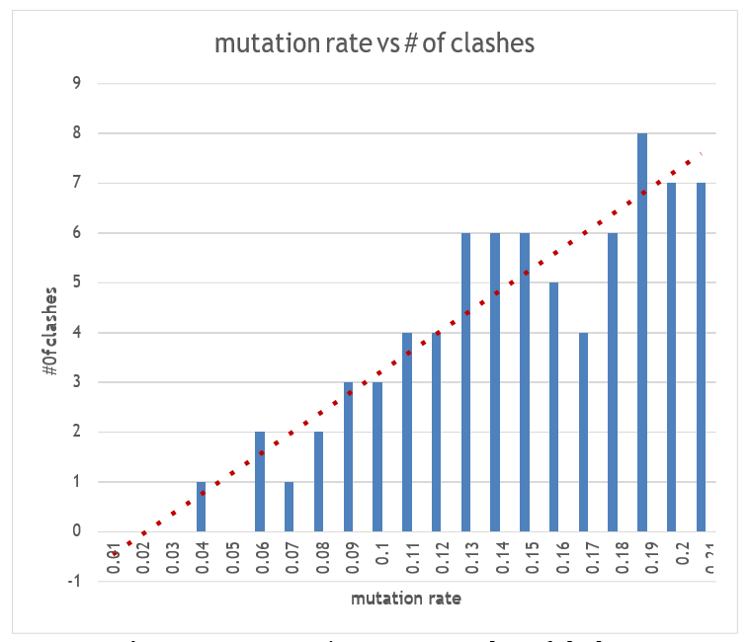
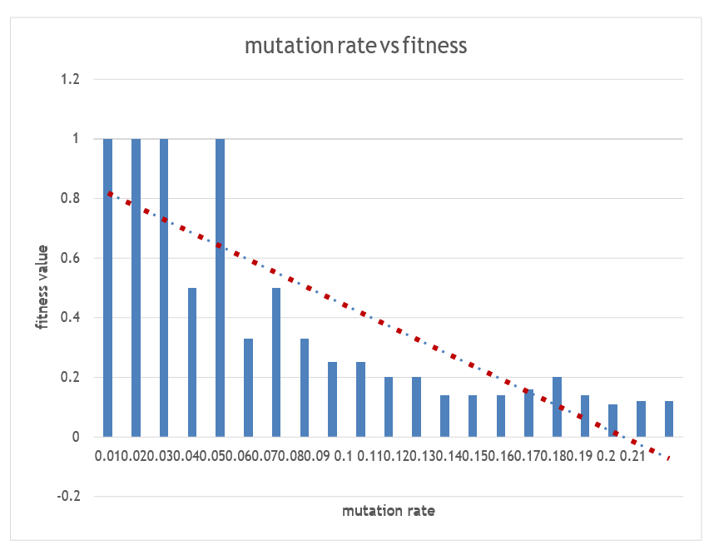
The limitation of Mutation

Slide 11
Conclusion
The mutation technique used guarantees that the mutated chromosomes remain valid
The factors such as population size, mutation rate, crossover rate, elite individuals, and tournament size were considered for the course scheduler
The optimum values for these factors were obtained through several runs of the system
the effect of mutation rate and the population size were studied for the course scheduler.

